Slide 1
Mu2e: Search for Muon to Electron Conversion at Fermilab
Eric Prebys Fermilab
For the Mu2e Collaboration

Slide 2
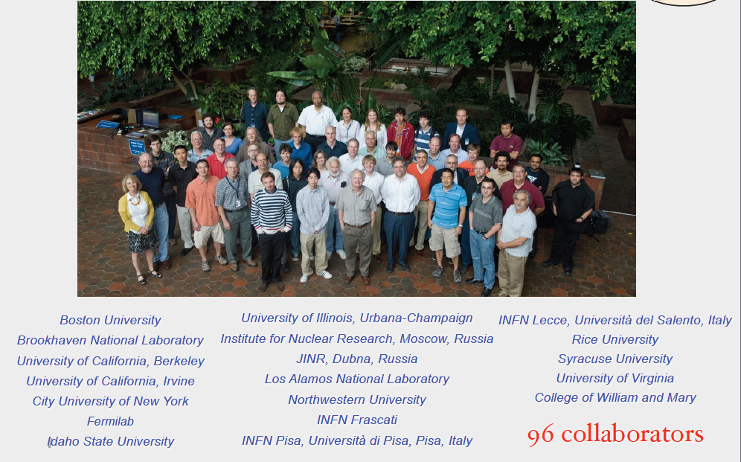
Mu2e Collaboration
~100 collaborators

Slide 3
Acknowledgement
This effort has benefited greatly from over a decade of voluminous work done by the MECO collaboration, not all of whom have chosen to join the current collaboration.

Slide 4
Outline
Theoretical Motivation
Experimental Technique
Making Mu2e work at Fermilab
Sensitivities
Future Upgrades
Conclusion
Will spend quite a bit of time on this

Slide 5
General
The study or rare particle decays allows us to probe mass scales far beyond those amenable to direct searches.
Among these decays, rare muon decays offer the possibility of experimentally clean and unambiguous evidence of physics beyond the current Standard Model.
Such searches are a natural part of the “Intensity Frontier”, which is being proposed for Fermilab after the end of the current collider program.
In the case of muon conversion, we can take advantage of a great deal of work that has already been done in the planning of the Muon to Electron Conversion Experiment (MECO), which was proposed at Brookhaven.

Slide 6
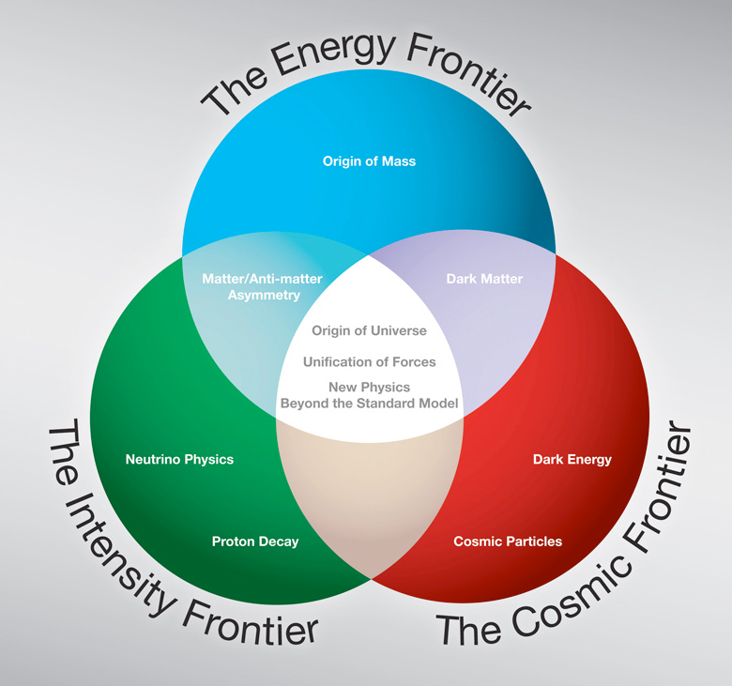
The Context (P5 View)
As the LHC takes over the energy frontier, Fermilab’s primary mission will shift

Slide 7
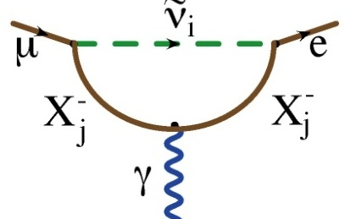
μ->e CLFV in the SM
First Order FCNC:
Higher order dipole “penguin”:
Virtual ν mixing
Forbidden in Standard Model
Observation of neutrino mixing shows this can occur at a very small rate
Photon can be real (μ->eγ) or virtual (μN->eN)
Standard model B.R. ~O(10⁻⁵⁰)

Slide 8
Beyond the Standard Model
Because extensions to the Standard Model couple the lepton and quark sectors, lepton number violation is virtually inevitable.
Charged Lepton Flavor Violation (CLFV) is a nearly universal feature of such models, and the fact that it has not yet been observed already places strong constraints on these models.
CLFV is a powerful probe of multi-TeV scale dynamics: complementary to direct collider searches
Among various possible CLFV modes, rare muon processes offer the best combination of new physics reach and experimental sensitivity

Slide 9
Strongly Endorsed in P5 “Roadmap”
From the P5 Report
“The experiment could go forward in the next decade with a modest evolution of the Fermilab accelerator complex. Such an experiment could be the first step in a world-leading muon-decay program eventually driven by a next-generation highintensity proton source. The panel recommends pursuing the muon-to-electron conversion experiment... under all budget scenarios considered by the panel”
Mu2e stands poised to play a central role in the US HEP program

Slide 10
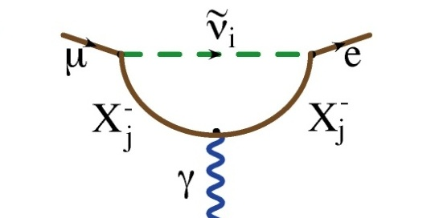
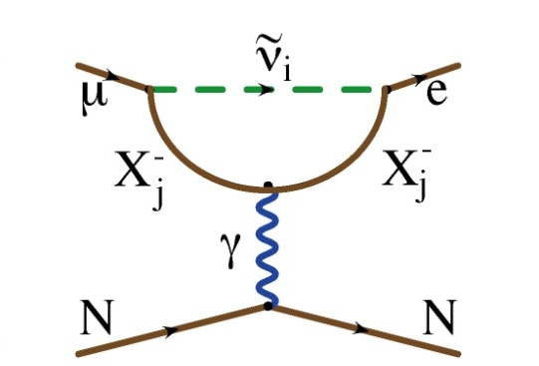
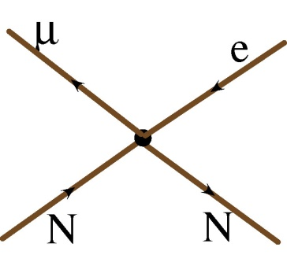
Generic Beyond Standard Model Physics
Flavor Changing Neutral Current
Dipole (penguin)
Can involve a real photon
Or a virtual photon
?
?
?
Mediated by massive neutral Boson, e.g.
Leptoquark
Z’
Composite
Approximated by “four fermi interaction”
?
?
?

Slide 11
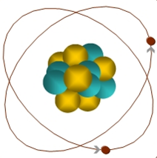
Muon-to-Electron Conversion: μ+N → e+N
When captured by a nucleus, a muon will have an enhanced probability of exchanging a virtual particle with the nucleus.
This reaction recoils against the entire nucleus, producing the striking signature of a mono-energetic electron carrying most of the muon rest energy
μ
105 MeV e⁻
Similar to μ→eγ, with important advantages:
No combinatorial background
Because the virtual particle can be a photon or heavy neutral boson, this reaction is sensitive to a broader range of BSM physics
Relative rate of μ→eγ and μN→eN is the most important clue regarding the details of the physics

Slide 12
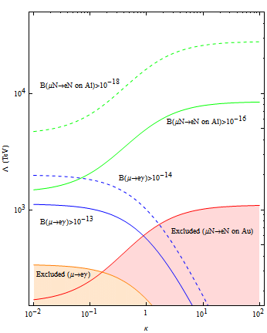
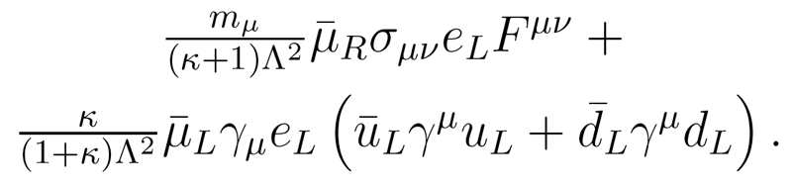
μ→e Conversion vs. μ→eγ
We can parameterize the relative strength of the dipole and four fermi interactions.
This is useful for comparing relative rates for μN→eN and μ→eγ
Courtesy: A. de Gouvea
Mu2e Phase-II
Mu2e Phase-I
Λ (TeV)
MEG Upgrade
?
MEG Projected
?
?
Sindrum II
MEGA
Loop
dominated
κ
Contact
dominated

Slide 13
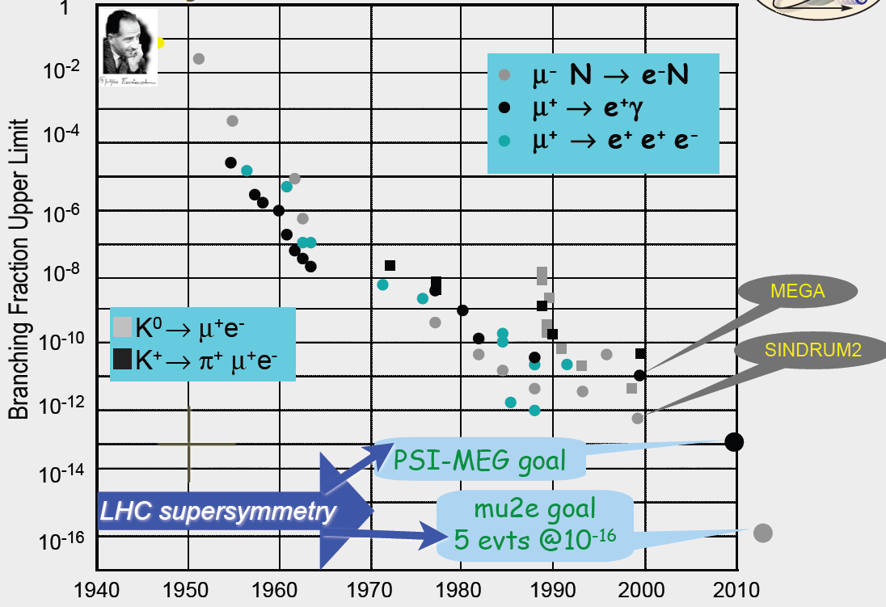
History of Lepton Flavor Violation Searches
1

Slide 14
Example Sensitivities*
Supersymmetry
Compositeness
Predictions at 10⁻¹⁵
Second Higgs doublet
Heavy Neutrinos
Heavy Z’, Anomalous Z coupling
Leptoquarks
*After W. Marciano

Slide 15
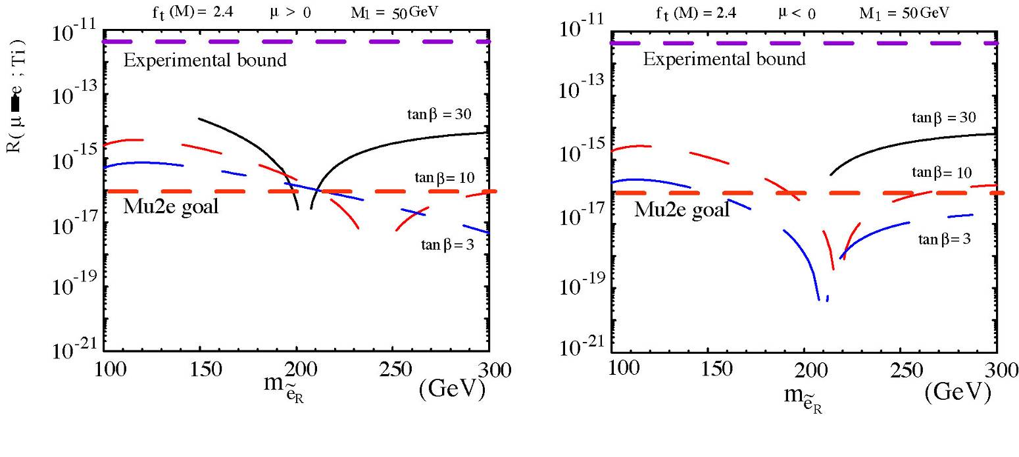
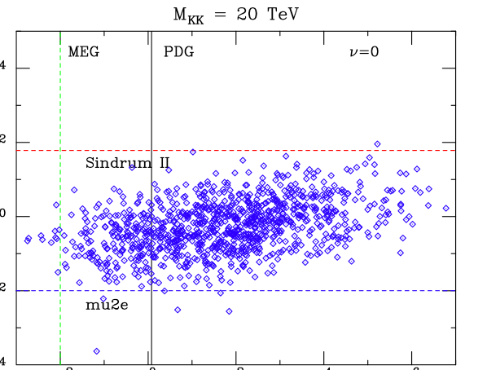
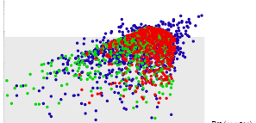
Sensitivity (cont’d)
SU(5) GUT Supersymmetry: κ << 1
Littlest Higgs: κ ≈ 1
Randall-Sundrum: κ ≈ 1
R(μTi→eTi)
R(μTi→eTi)
Examples with κ>>1 (no μ→eγ signal):
Leptoquarks
Z-prime
Compositeness
10⁻¹⁰
MEG
10⁻¹⁰
10⁻¹²
10⁻¹²
10⁻¹⁴
10⁻¹⁴
10⁻¹⁶
10⁻¹⁶
mu2e
10⁻¹⁵
10⁻¹³
10⁻¹¹
10⁻¹³
10⁻¹¹
10⁻⁹
Br(μ→eγ)
Br(μ→eγ)

Slide 16
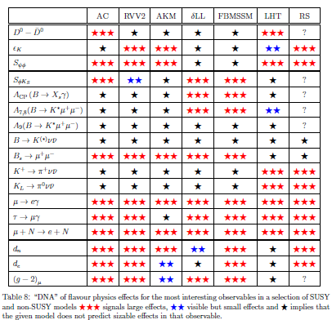
μ→e in SUSY*
SUSY Models
Always a μ→e signal
*from Altmannshofer, Buras, et al, Nucl.Phys.B830:17-94, 2010

Slide 17
Decay in Orbit (DIO) Backgrounds: Our Biggest Issue
Ordinary:
Coherent:
N
Very high rate
Peak energy 52 MeV
Must design detector to be very insensitive to these.
Nucleus coherently balances momentum
Rate approaches conversion (endpoint) energy as (E_{s}-E)⁵
Drives resolution requirement.

Slide 18
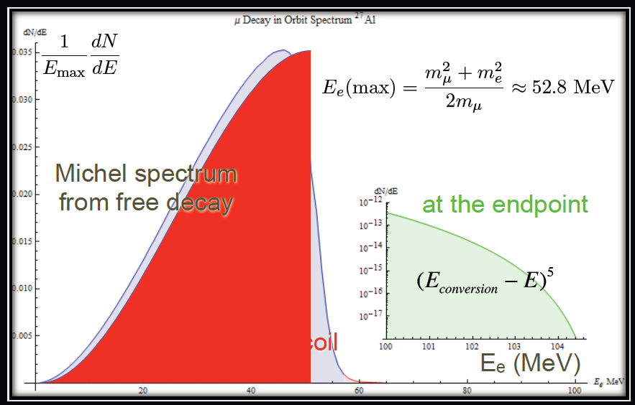
DIO Spectrum

Slide 19
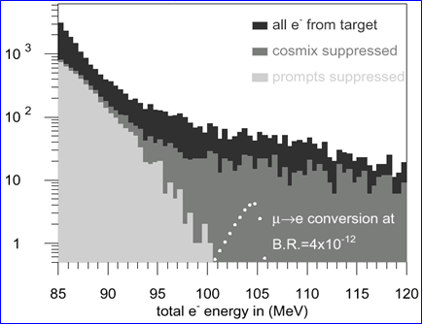
Previous muon decay/conversion limits (90% C.L.)
μ−>e Conversion: Sindrum II
LFV μ Decay:
High energy tail of coherent Decay-in-orbit (DIO)
Rate limited by need to veto prompt backgrounds!

Slide 20
Mu2e (MELC⇒MECO) Philosophy
Eliminate prompt beam backgrounds by using a primary beam with short proton pulses with separation on the order of a muon life time
Design a transport channel to optimize the transport of right-sign, low momentum muons from the production target to the muon capture target.
Design a detector to strongly suppress electrons from ordinary muon decays
~100 ns
~1.5 μs
Prompt backgrounds
live window

Slide 21
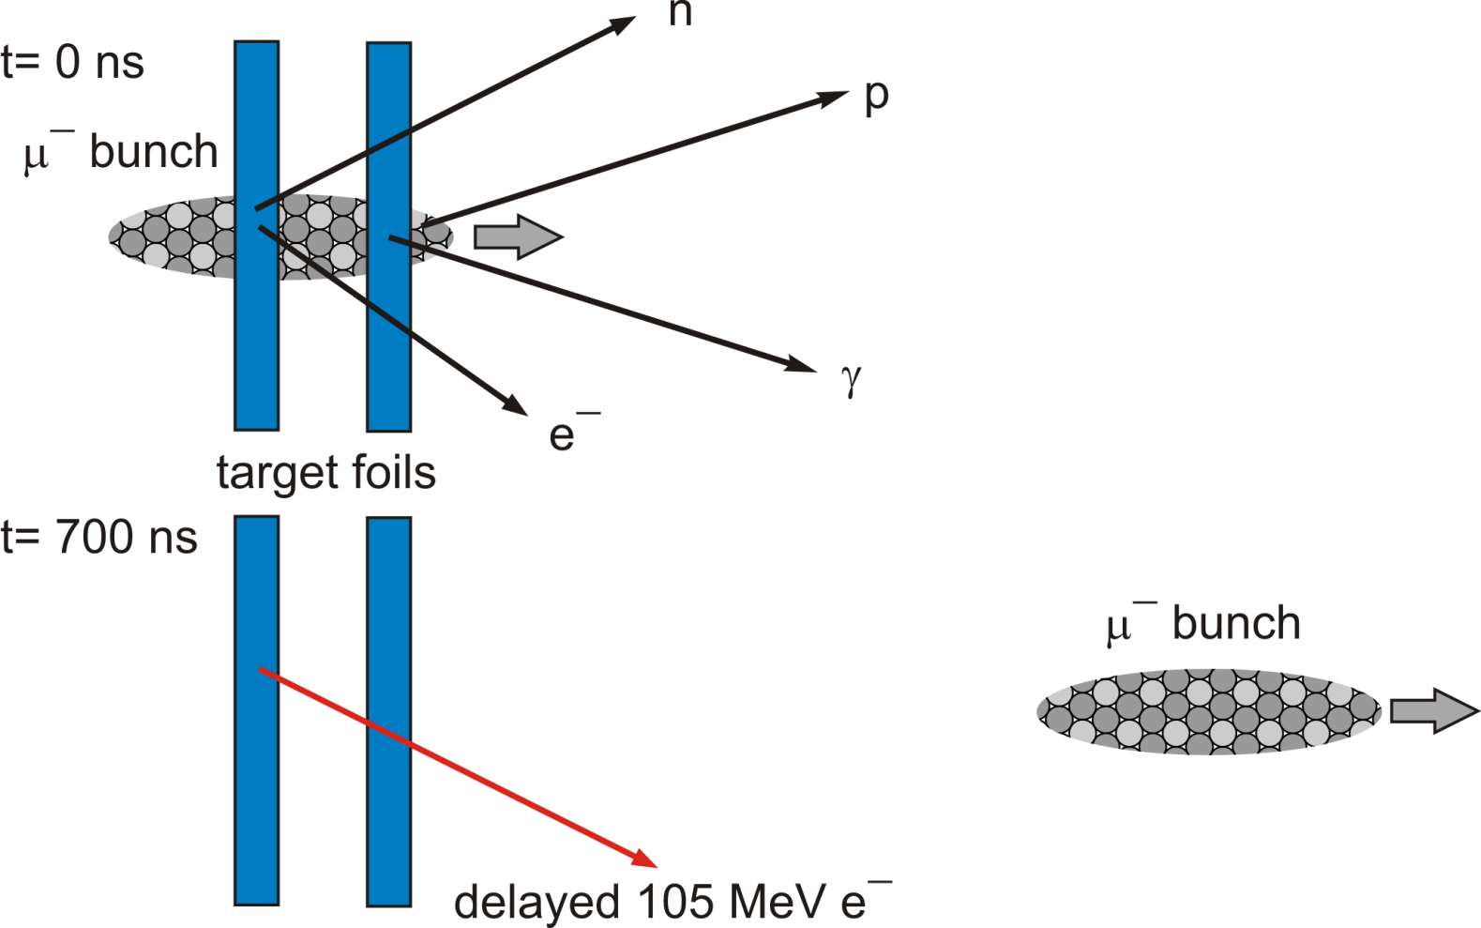
Signal
Single, monoenergetic electron with E=105 MeV, coming from the target, produced ~1 μs (τ_{μAl} ~ 880ns) after the “μ” bunch hits the target foils
Need good energy resolution: ≲ 0.200 MeV
Need particle ID
Need a bunched beam with less than 10⁻⁹ contamination between bunches

Slide 22
Choosing the Capture Target
Dipole rates are enhanced for high-Z, but
Lifetime is shorter for high-Z
Decreases useful live window
Also, need to avoid background from radiative muon capture
⇒Want M(Z)-M(Z-1) < signal energy
⇒Aluminum is nominal choice for Mu2e
Nucleus
R_{μe}(Z) / R_{μe}(Al)
Bound lifetime
Atomic Bind. Energy(1s)
Conversion Electron Energy
Prob decay >700 ns
Al(13,27)
1.0
.88 μs
0.47 MeV
104.97 MeV
0.45
Ti(22,~48)
1.7
.328 μs
1.36 MeV
104.18 MeV
0.16
Au(79,~197)
~0.8-1.5
.0726 μs
10.08 MeV
95.56 MeV
negligible

Slide 23
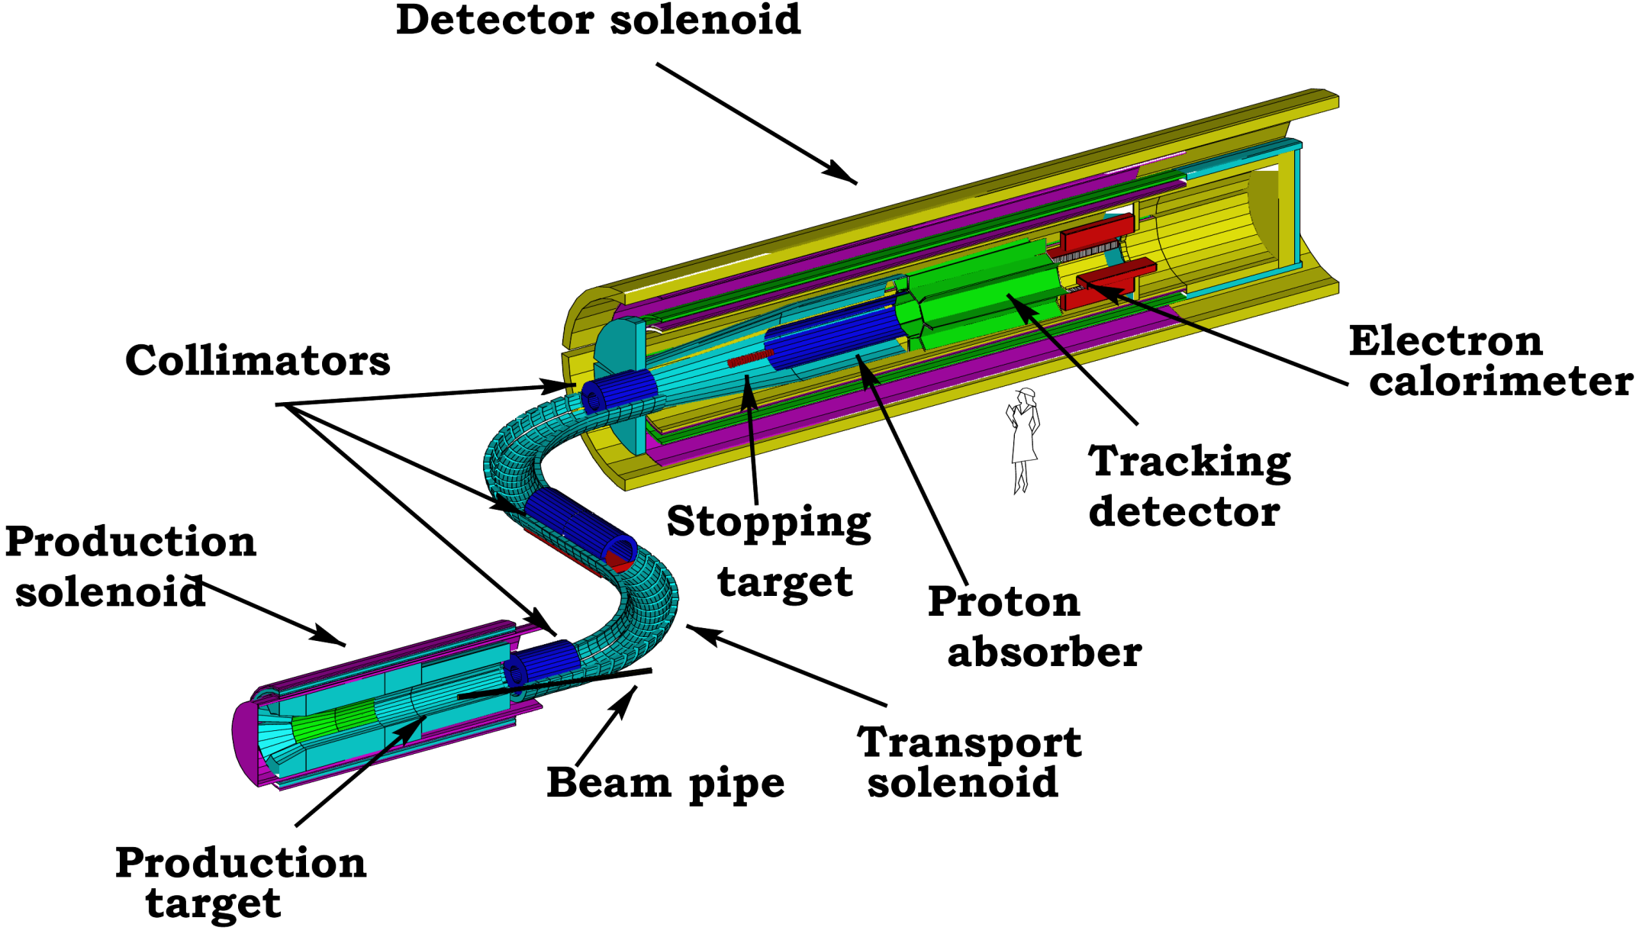
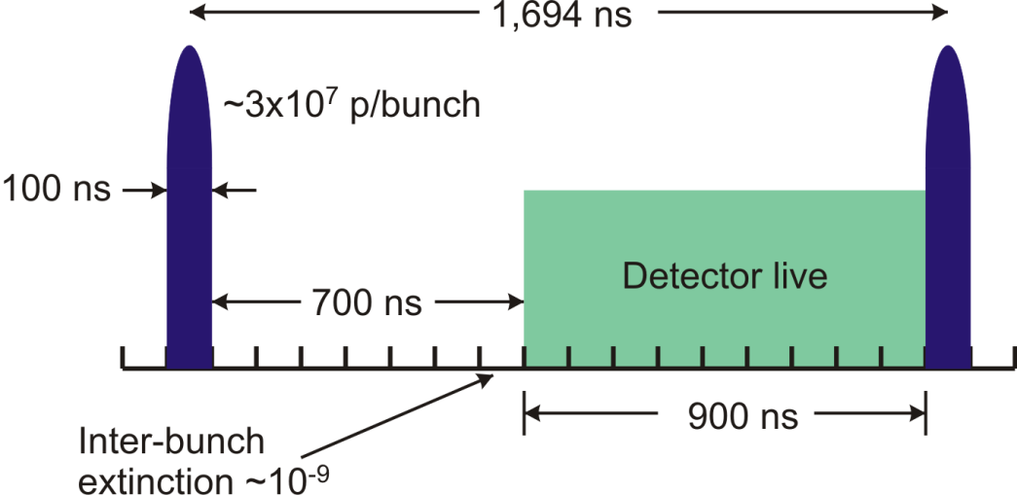
mu2e Muon Beam and Detector
for every incident proton 0.0025 μ⁻’s are stopped in the 17 0.2 mm Al target foils

Slide 24
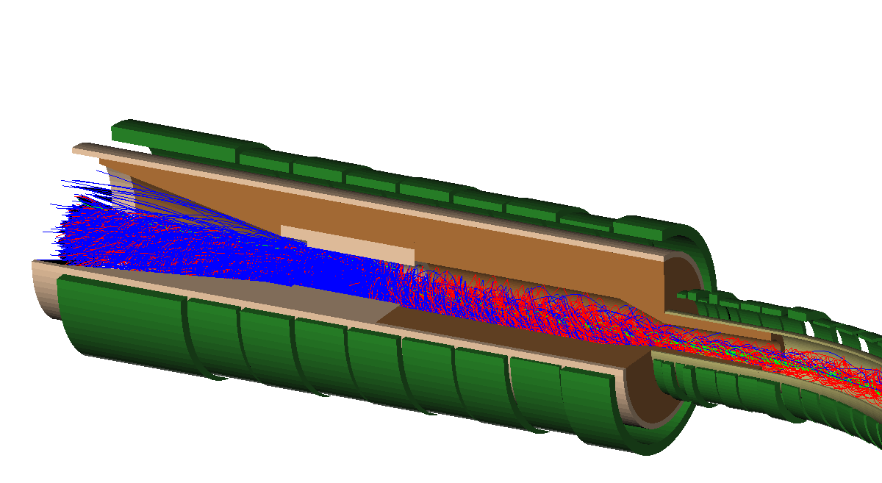
Production Region
Axially graded 5 T solenoid captures low energy backward and reflected pions and muons, transporting them toward the stopping target
Cu and W heat and radiation shield protects superconducting coils from effects of 50kW primary proton beam
5T
Graded Solenoid Field
2.5T
Incident protons
Mu2e detector
Production Target

Slide 25
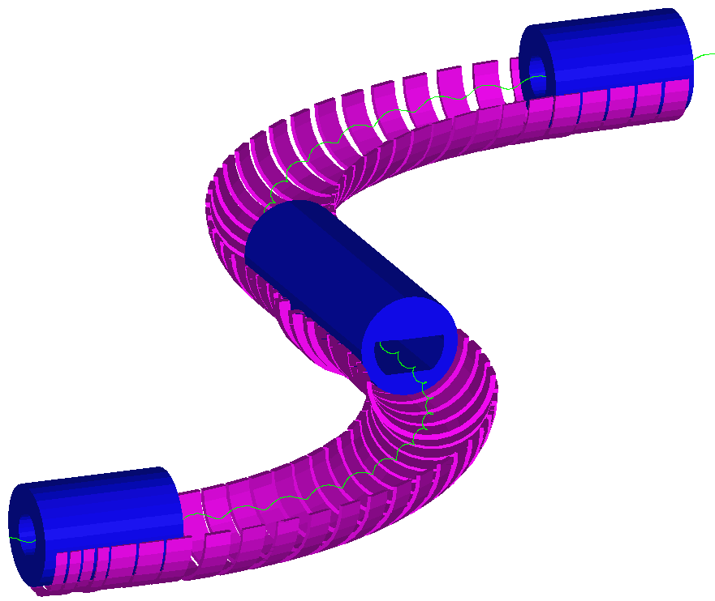
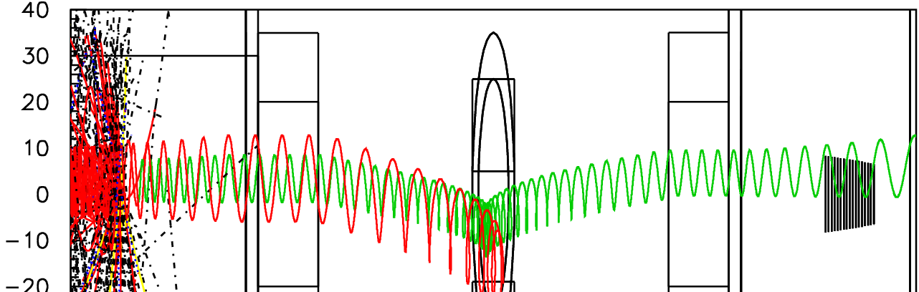
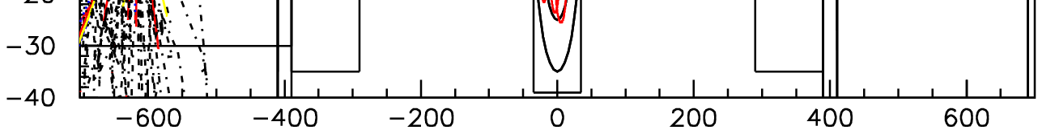
Transport Solenoid
Curved solenoid eliminates line-of-sight transport of photons and neutrons
Curvature drift and collimators sign and momentum select beam
dB/ds < 0 in the straight sections to avoid trapping which would result in long transit times
Collimators and pBar Window
2.1 T
2.5 T

Slide 26
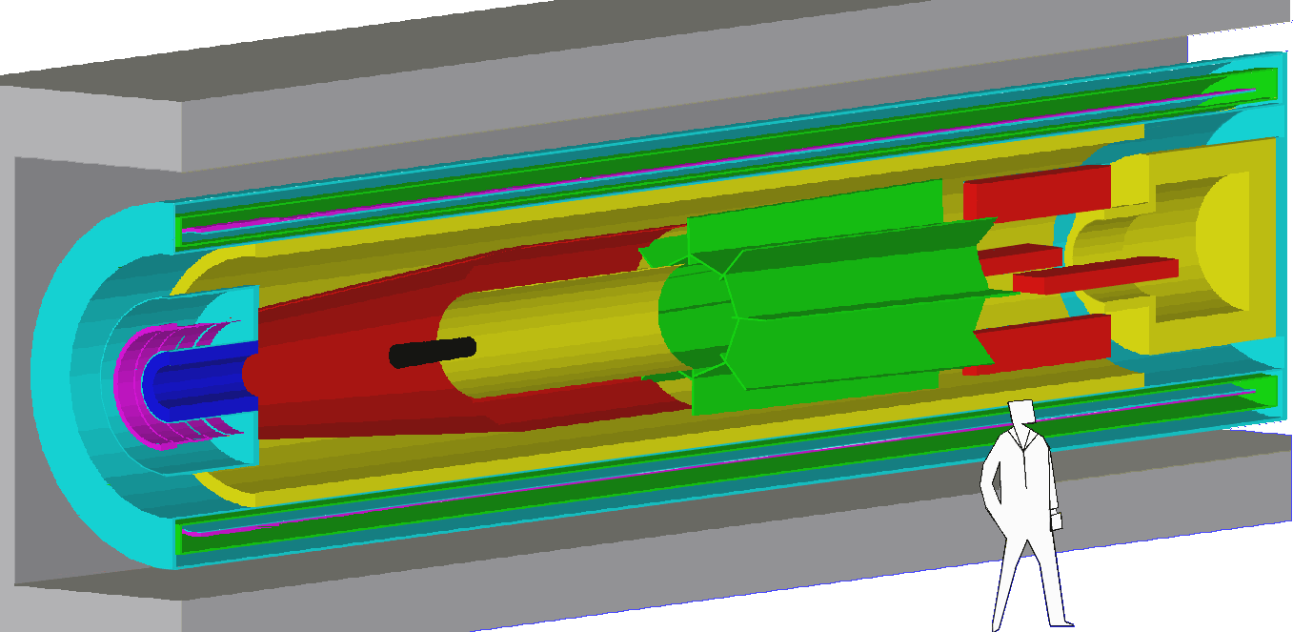
Detector Region
Axially-graded field near stopping target to sharpen acceptance cutoff.
Uniform field in spectrometer region to simplify momentum analysis
Electron detectors downstream of target to reduce rates from γ and neutrons
Stopping Target Foils
Straw Tracking Detector
2 T
1 T
1 T
Electron Calorimeter

Slide 27
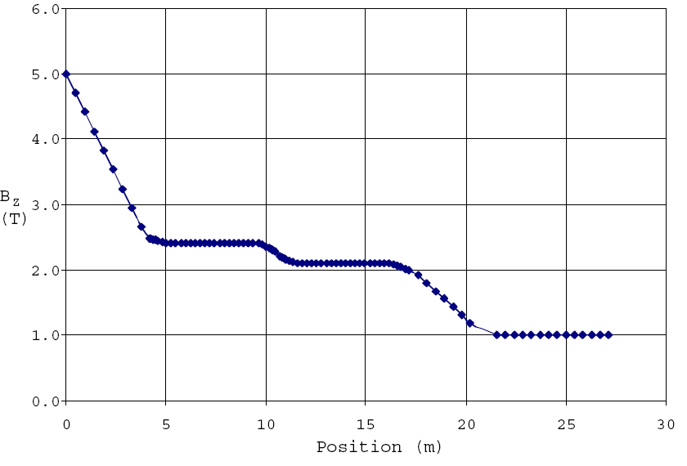
Magnetic Field Gradient
Production Solenoid
Transport Solenoid
Detector Solenoid

Slide 28
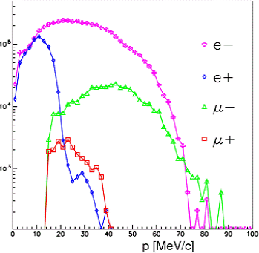
Transported Particles
Vital that e- momentum < signal momentum
E~3-15 MeV

Slide 29
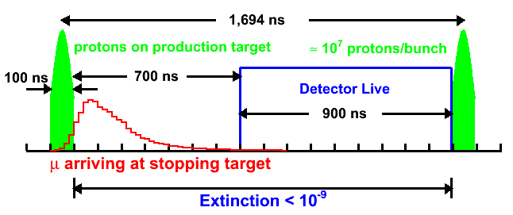
One Cycle of the Muon Beamline
μ⁻ are accompanied by e⁻, π⁻, …
Extinction required to make prompt background ~equal to all other backgrounds
1 out of time proton per 10⁹ in time protons.
Lifetime of muonic Al: 864 ns.

Slide 30
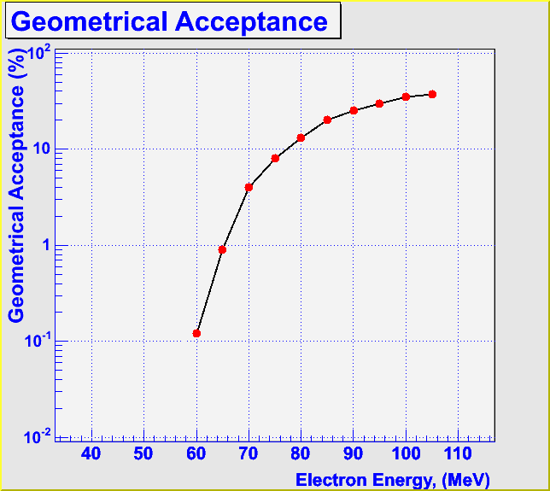
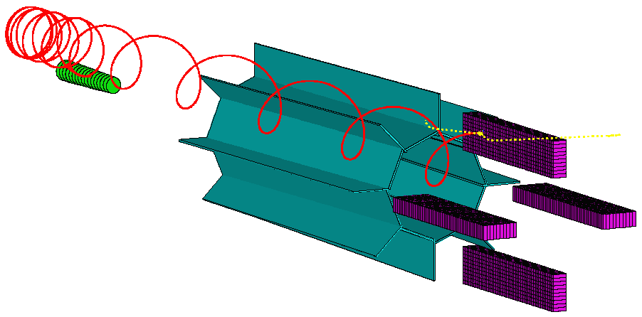
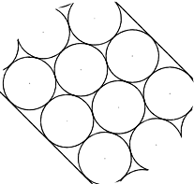
Tracking Detector/Calorimeter (“L-Tracker”)
3000 2.6 m straws
σ(r,φ) ~ 0.2 mm
17000 Cathode strips
σ(z) ~ 1.5 mm
1200 PBOW4 cyrstals in electron calorimeter
σE/E ~ 3.5%
Resolution: .19 MeV/c

Slide 31
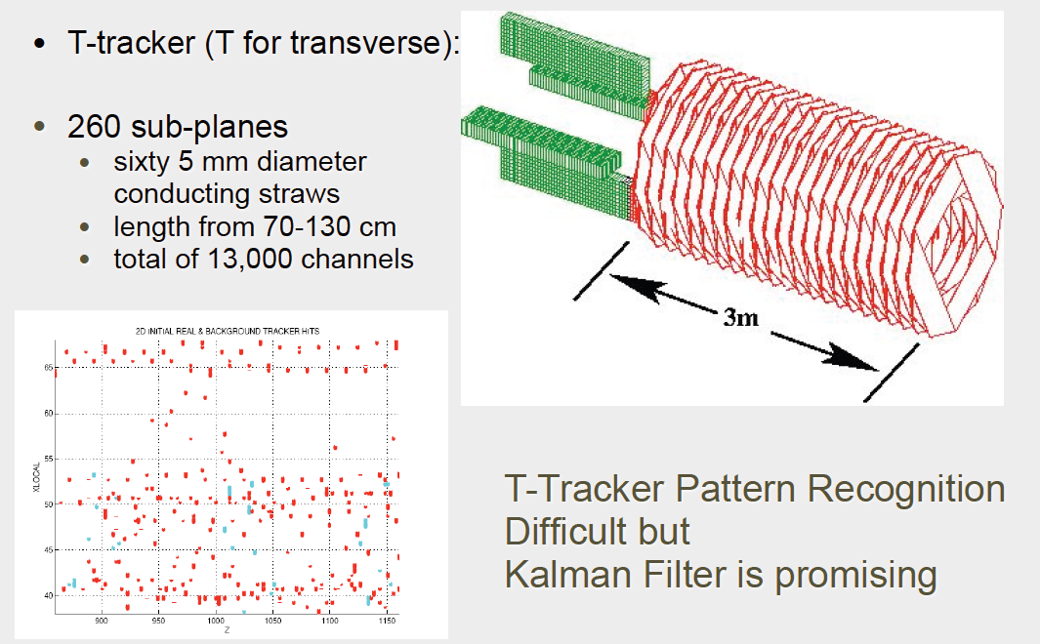
Alternate Tracker Design

Slide 32
A long time coming
1992 | MELC proposed at Moscow Meson Factory
1997 | MECO proposed for the AGS at Brookhaven as part of RSVP (at this time, experiment incompatible with Fermilab)
1998-2005 | intensive work on MECO technical design: magnet system costed at $58M, detector at $27M
July 2005 | RSVP cancelled for financial reasons
2006 | MECO subgroup + Fermilab physicists work out means to mount experiment at Fermilab
June 2007 | mu2e EOI submitted to Fermilab
October 2007 | LOI submitted to Fermilab
Fall 2008 | mu2e submits proposal to Fermilab
November 2008 | Stage 1 approval. Formal Project Planning begins
November 2009 | DOE Grants CD-0

Slide 33
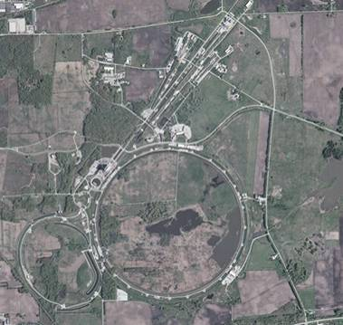
Mu2e at Fermilab
Fermilab
Built ~1970
200 GeV proton beams
Eventually 400 GeV
Upgraded in 1985
900GeV x 900 GeV p-pBar collisions
Most energetic in the world ever since
Upgraded in 1997
Main Injector-> more intensity
980 GeV x 980 GeV p-pBar collisions
Intense neutrino program
Soon the second most powerful collider
What next???
There should be enough protons to do Mu2e in the NOvA era, but generating the bunch structure is very complicated...
until recently
Now

Slide 34
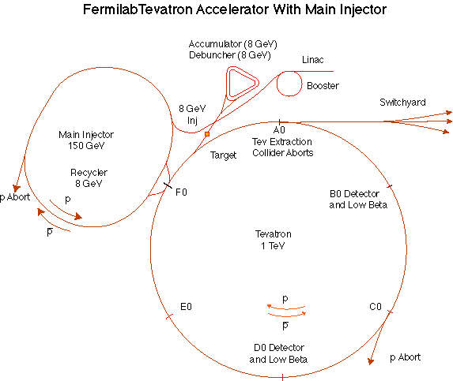
The Fermilab Accelerator Complex
We will use all of this
MiniBooNE/BNB
NUMI

Slide 35
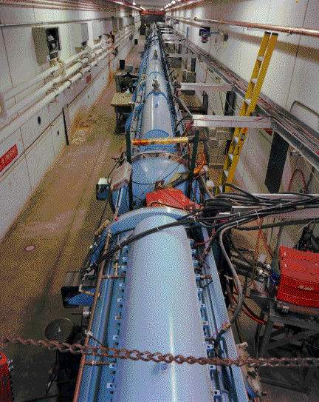
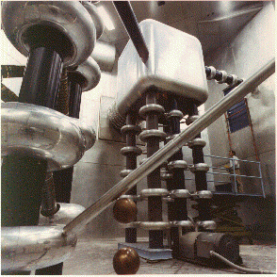
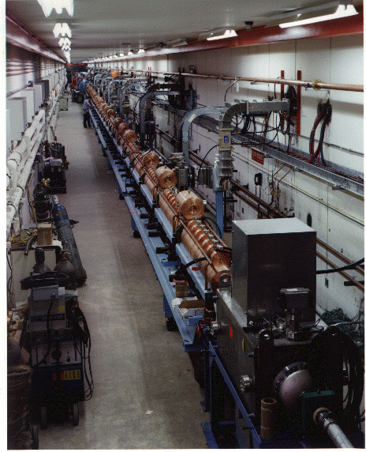
Preac(cellerator) and Linac
“New linac” (HEL)- Accelerate H- ions from 116 MeV to 400 MeV
“Preac” - Static Cockroft-Walton generator accelerates H- ions from 0 to 750 KeV.
“Old linac”(LEL)- accelerate H- ions from 750 keV to 116 MeV

Slide 36
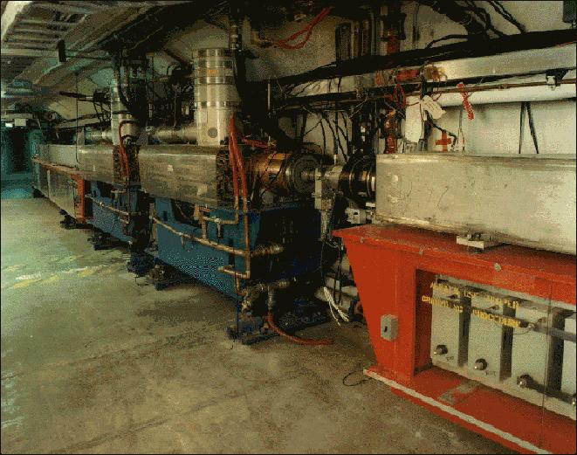
Booster
Accelerates the 400 MeV beam from the Linac to 8 GeV
Operates in a 15 Hz offset resonant circuit
No flat top ⇒ no chance to rebunch!
Sets fundamental clock of accelerator complex
From the Booster, 8 GeV beam can be directed to
The Main Injector
The Booster Neutrino Beam (MiniBooNE)
A dump.
More or less original equipment

Slide 37
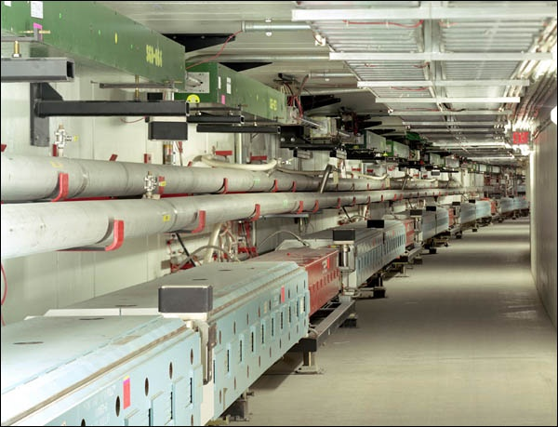
Main Injector/Recycler
The Main Injector can accept 8 GeV protons OR antiprotons from
Booster
The anti-proton accumulator
The 8 GeV Recycler (which shares the same tunnel and stores antiprotons)
It can accelerate protons to 120 GeV (in a minimum of 1.4 s) and deliver them to
The antiproton production target.
The fixed target area.
The NUMI beamline.
It can accelerate protons OR antiprotons to 150 GeV and inject them into the Tevatron.

Slide 38
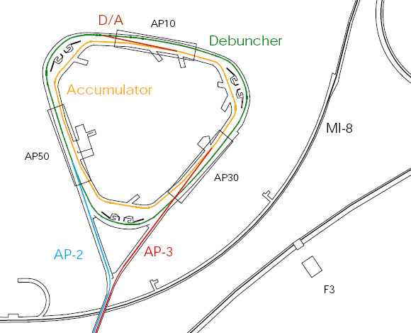
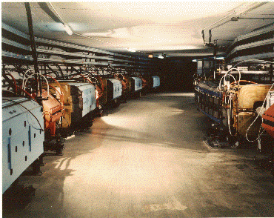
Present Operation of Debuncher/Accumulator
Protons are accelerated to 120 GeV in Main Injector and extracted to pBar target
pBars are collected and phase rotated in the “Debuncher”
Transferred to the “Accumulator”, where they are cooled and stacked
pBars not used after collider.

Slide 39
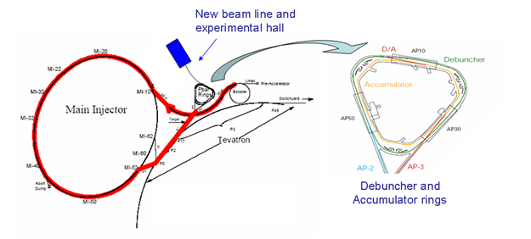
Protons→Accumulator: “Boomerang” Scheme
MI-8 -> Recycler: Key Nova Upgrade
Recycler (Main Injector Tunnel)
New extraction magnet
Deliver beam to Accumulator/Debuncher enclosure with minimal beam line modifications and no civil construction.

Slide 40
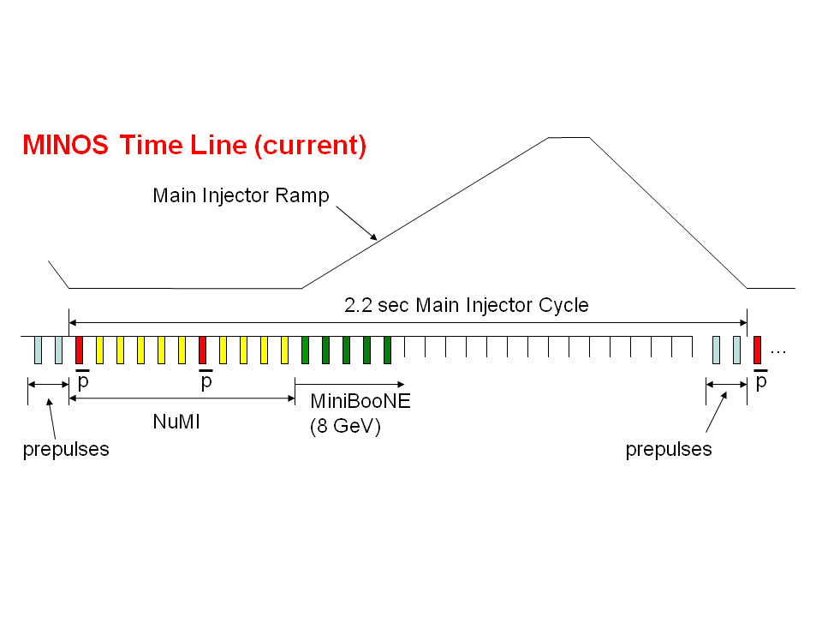
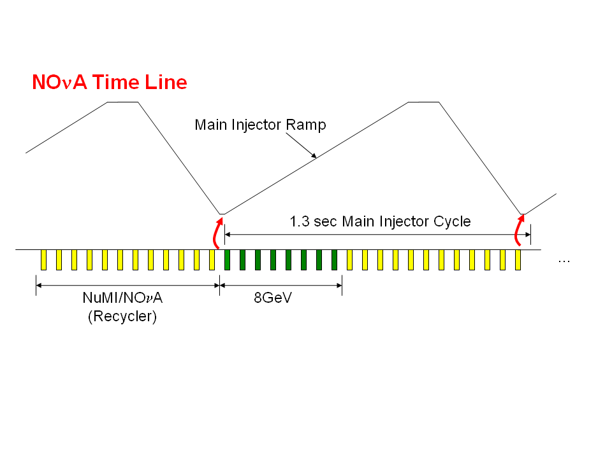
NOνA time line improvements
300 kW
Present: must allow time at injection energy to load protons into Main Injector
700 kW
Upgrade: a new transfer line will allow us to “prestack” in the Recycler

Slide 41
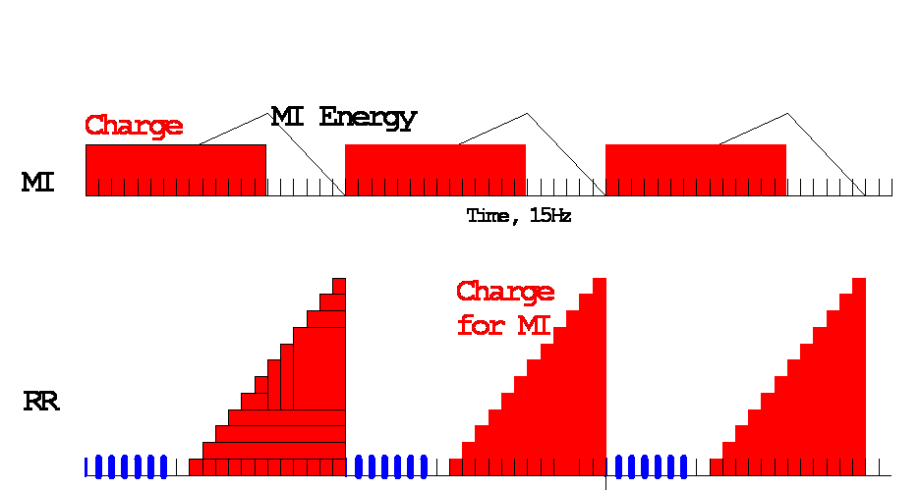
Available Protons: NOvA Era
MI uses 12 of 20 available Booster Batches per 1.33 second cycle
Preloading for NOvA
Recycler
Recycler → MI transfer
Available for 8 GeV program
15 Hz Booster cycles
MI NuMI cycle (20/15 s)
Roughly 8*(4x10¹² batch)/(1.33 s)*(2x10⁷ s/year)=4.8x10²⁰ protons/year available

Slide 42

Threading Mu2e through Recycler
NOvA batch
3
6
5
1
6
2
2
5
4
1
Recycler
Mu2e batch
1
4
2
3
5
6
1
4
3
6
4
3
5
2
2
5
6
1
3
4
3
6
2
1
4
5
from Booster
to Accumulator
Recycler circumference is 7 times the Booster
NOvA accepts 6 “batches” from Booster, then performs “slip stacking” to a slightly different energy (and hence different orbit) in order to accept 6 more
Use the existing “gap” to thread beam through toward Mu2e
This gives us great flexibility in sending beam to the Accumulator

Slide 43
Momentum stacking in Accumulator
Energy
T=0
1st batch is injected onto the injection orbit
T<66ms
1st batch is accelerated to the core orbit
Inject a newly accelerated Booster batch every 67 mS onto the low momentum orbit of the Accumulator
The freshly injected batch is accelerated towards the core orbit where it is merged and debunched into the core orbit
Momentum stack up to 3 Booster batches
T=67ms
2nd Batch is injected
T<133ms
2nd Batch is accelerated
T=134ms
3rd Batch is injected

Slide 44
Rebunching and transfer to Debuncher
Beam in the Accumulator is bunched into four bunches.
These can be transferred one at a time into the Debuncher.

Slide 45
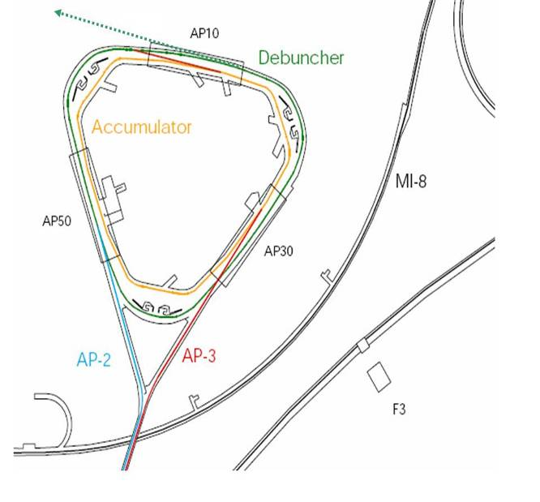
Resonant Extraction
A resonance is driven to slowly extract the single bunch which is circulating around the Debuncher.
The result is a train of bunches separated by the period of the Debuncher (~1.7 μs)
~100 ns
~1.6 μs

Slide 46
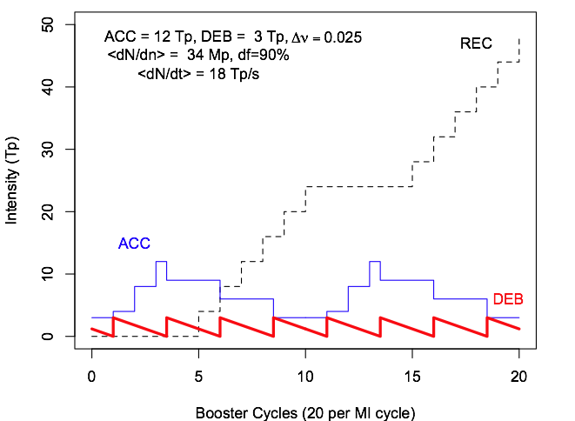
Mu2e Time Line

Slide 47
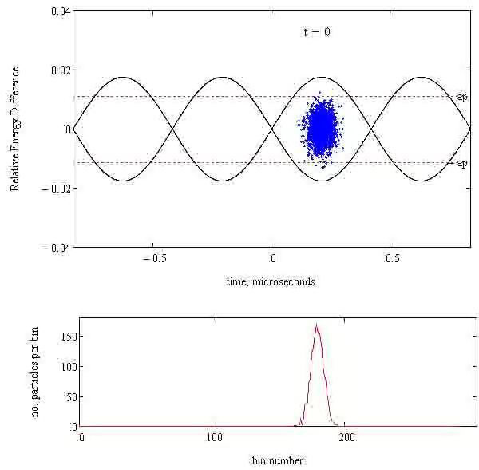
Extinction in the Rings
RF noise, gas interaction, and intrabeam scattering cauase beam to “wander out” of the RF bucket.
D is the dispersion function:
Transverse Offset = ΔE/E × D
Anticipate installation of collimator in region with dispersion, removing off-momentum particles:
Momentum scraping

Slide 48
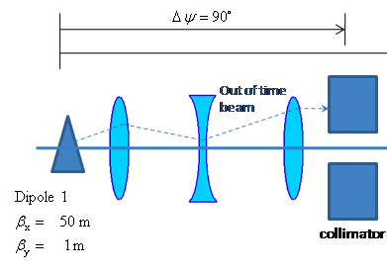
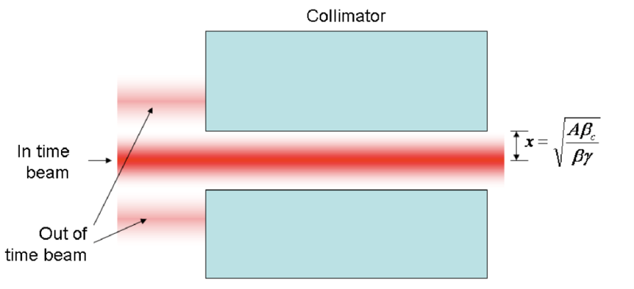
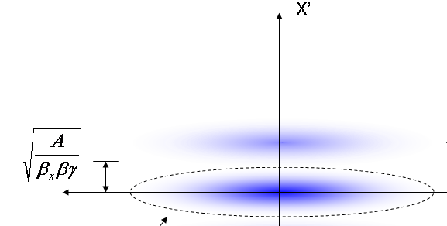
External Extinction (AC-Dipole System)
Baseline design, single collimator
At dipole:
A system of resonant dipoles steers out of time beam into a collimator

Slide 49



Three Classes of Backgrounds
1. Stopped Muon Induced Backgrounds
Muon decay in orbit:
μ⁻ → e⁻νν
E_{e} < m_{μ}c² – E_{NR} – E_{B}
N ∼ (E₀ - E_{e})⁵
Fraction within 3 MeV of endpoint ∼ 5x10⁻¹⁵
Defeated by good energy resolution
Radiative muon capture:
μ⁻Al → γνMg
γ endpoint 102.5 MeV
10⁻¹³ produce e⁻ above 100 MeV
Defeated by good energy resolution and choice of target

Slide 50


Backgrounds (continued)
2. Beam Related Backgrounds
Goal: Prompt background ~equal to all other backgrounds
Muon decay in flight:
μ⁻ → e⁻νν
Since E_{e} < m_{μ}c²/2, p_{μ} > 77 GeV/c
Radiative π⁻ capture:
π⁻N →N*γ, γZ → e⁺e⁻
Beam electrons
Pion decay in flight:
π⁻ → e⁻ν_{e}
Suppressed by minimizing beam between bunches
Need ≲ 10⁻⁹ extinction (see previous discussion)
Baseline design, single collimator
3. Asynchronous Backgrounds
Cosmic rays
suppressed by active and passive shielding

Slide 51
What we Get
Proton flux | 2x10¹³ p/s
Running time | 2x10⁷ s
Total protons | 4x10²⁰ p/yr
μ⁻ stops/incident proton | 0.0025
μ⁻ capture probability | 0.60
Time window fraction | 0.49
Electron trigger efficiency | 0.90
Reconstruction and selection efficiency | 0.19
Detected events for R_{μe} = 10⁻¹⁶ | 5.0

Slide 52

The Bottom Line
Blue text: beam related.
Roughly half of background is beam related, and half interbunch contamination related
Total background per 4x10²⁰ protons, 2x10⁷ s: 0.4 events
Signal for R_{μe} = 10⁻¹⁶: 5 events Single even sensitivity: 2x10⁻¹⁷ 90% C.L. upper limit if no signal: 6x10⁻¹⁷

Slide 53


Significance
For 4x10²⁰ protons on target

Slide 54
Mu2e Status and Schedule
November, 2009: DOE CD-0 approval
Hope for CD-1 ~mid-2011
Current schedule ⇒ first data in ~2017
Cost estimated at $ 200M (fully loaded, escalated, and including contingencies)
Mu2e Experiment Technically Limited Schedule
2009 |  |  |  | 2010 |  |  |  | 2011 |  |  |  | 2012 |  |  |  | 2013 |  |  |  | 2014 |  |  |  | 2015 |  |  |  | 2016 |  |  |  | 2017 |  |  |  | 2018
Q1 | Q2 | Q3 | Q4 | Q1 | Q2 | Q3 | Q4 | Q1 | Q2 | Q3 | Q4 | Q1 | Q2 | Q3 | Q4 | Q1 | Q2 | Q3 | Q4 | Q1 | Q2 | Q3 | Q4 | Q1 | Q2 | Q3 | Q4 | Q1 | Q2 | Q3 | Q4 | Q1 | Q2 | Q3 | Q4 | Q1 | Q2 | Q3 | Q4
R&D +
Conceptual Design
R&D +
Final Design
Construction
Data Taking
CD-0
CD-1
CD-2
CD-3
CD-4

Slide 55
Present areas of active research
Proton delivery
Accumulator/Debuncher loading schemes
Resonant extraction
Extinction and extinction measurement
Optimizing magnet design
Original design based on SSC superconductor, which has since mysteriously vanished.
Is magnetic mirror worth it?
Models and data on low energy pion production have come a long way in recent years.
New detector options
T-tracker
low pressure drift chamber
Similar mass and less probability of fakes
Physics!!
Rates and backgrounds
New analysis tools (Geant4, CMS Framework)
Calibration schemes
How can we convince the world we can measure something at a < 10⁻¹⁶ BR?
Siting optimization and synergy with other programs
g-2
Muon collider R&D

Slide 56

Looking toward the future: Project X
Maximizing the intensity of the Main Injector will require replacing Fermilab’s aging proton source.
In 2007 the Long Range Steering committee endorsed a design based on a linac incorporating ILC RF technology
Temporarily named “Project X”
Specification has undergone many iterations. Current encarnation
Muon program driven by 3 GeV CW linac beam

Slide 57
Comments on Project X Era
Some pressure to skip current proposal and go straight to Project X, but…
Existing experiment will increase sensitivity 4-5 orders of magnitude over current measurement
This will be very challenging
Project X could potentially push limit another 2 orders of magnitude.
Is it reasonable to try to go 6 orders of magnitude in one step?
Hint: No
Would have very different priorities depending on whether current proposal sees a signal
Not realistic to think of designing a Project X experiment without input from Mu2e

Slide 58



Upgrade scenarios
Mu2e Signal?
No
Yes
Both prompt and DIO backgrounds must be lowered to measure
Must upgrade all aspects of production, transport and detection.
Must compare different targets.
Optimize muon transport and detector for short bound muon lifetimes.
Backgrounds might not be as important.
Rμe ~ 10⁻¹⁸

Slide 59
Experimental Challenges for Increased Flux
Achieve sufficient extinction of proton beam.
Current extinction goal directly driven by total protons
Upgrade target and capture solenoid to handle higher proton rate
Target heating
Quenching or radiation damage to production solenoid
Improve momentum resolution for the ~100 MeV electrons to reject high energy tails from ordinary DIO electrons.
Limited by multiple scattering in target and detector planes
Requirements at or beyond current state of the art.
Operate with higher background levels.
High rate detector
Manage high trigger rates
All of these efforts will benefit immensely from the knowledge and experience gained during the initial phase of the experiment.
If we see a signal a lower flux, can use increased flux to study in detail
Precise measurement of R_{μe}
Target dependence
Comparison with μ→eγ rate

Slide 60
Conclusions
We have proposed a realistic experiment to measure
Single event sensitivity of R_{μe}=2x10⁻¹⁷
90% C.L. limit of R_{μe}<6x10⁻¹⁷
This represents an improvement of more than four orders of magnitude compared to the existing limit, or over a factor of ten in effective mass reach. For comparison
TeV -> LHC = factor of 7
LEP 200 -> ILC = factor of 2.5
Potential future upgrades could increase this sensitivity by one or two orders of magnitude
ANY signal would be unambiguous proof of physics beyond the Standard Model
The absence of a signal would be a very important constraint on proposed new models.

